Slide 1

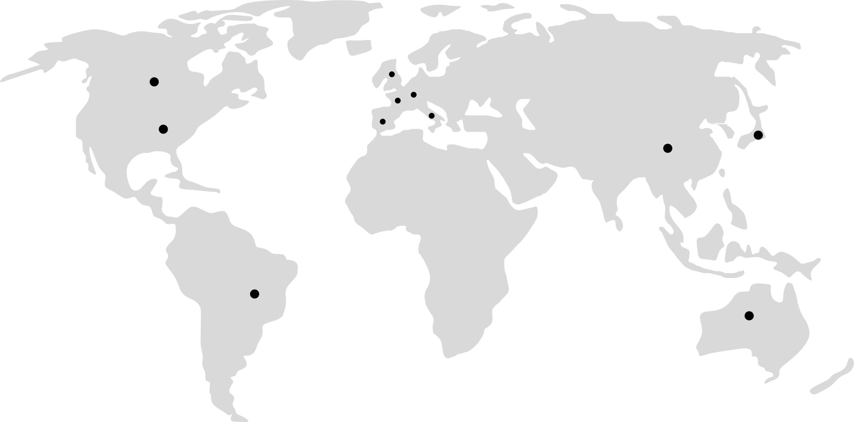
Markets:
US
Germany
Spain
France
UK
Italy
Brazil
Japan
Australia
Canada

Slide 2
Specialties:
General Practice / Family Practice Internal Medicine
Pediatrics Ophthalmology Psychiatry
Ob-Gyn (Obstetrics and Gynecology) Pulmonology
Cardiology
Endocrinology / Diabetology Dermatology Gastroenterology Neurology
Nephrology Rheumatology Oncology / Hematology Urology
Orthopedic Surgery General Surgery Radiology Veterinary Medicine

Slide 3

What Set the ROS Research Panels Apart from All Others:
Our rigorous panel management methods ensure that every panelist is credible & willing to share the most insightful responses to research questions.
Invitation Method: Rather than relying on mass email invitations, ROS intercepts potential panelists at 20+ B2B, B2C, Technology and international websites
Recruitment Method: All panelist are subject to a proprietary double opt-in recruitment process
Phone verification: Unlike any other panel provider, every new panelist is interviewed & screened by telephone
Specialty panels: All panelists are highly profiled and invited to participate in a specialty panel based on his or her specific interests
Survey Engagement: Our ongoing profiling process yields survey participation rates between 50%-70% depending on the specific panel

Slide 4
Research Panels are Only as Good as the Recruitment Method Used: Ours is the Best
Invitation
Intercepts occur at 20+ partner websites
This ensure active interest in specific & diverse topics
Verification
With 24 hours, all panelists are interviewed by phone
This ensures native language speaking ability
Sub-panel Invitation
Profiling seeks to understand the depth to which a panelist can provide insights relative to a topic of interest
Recruitment
Double opt-in capturing email and phone contact information
Email IP address must match phone country and area code
Profiling
Each new panelist participates in an extensive profiling exercise
This ensures captures panelist interests and behaviors

Slide 5
Invitation & Sub-Panel Creation Process
ROS Panelist are invited to join based on intercepts & partnerships with websites of various Interest, verifying active interest and/or participation in specific activities. Some examples include:
 | Physician Databases |  |  | New Mothers
 | Other HCP Databases |  |  | Consumer Registries
 | Consumer Healthcare Sites |  |  | Real Estate Sites
 | Automotive Registration |  |  | People Finding Sites
 | Voter Registration |  |  | Online Retailers

Slide 6

In-survey Quality Detection Processes
ROS Research employs 8 different quality checks during every online survey
Duplicate account detection (email, panel ID, and profile matching)
IP address and geo-location verification, including VPN and proxy detection
Device fingerprinting to prevent multiple enrollments from the same device
Survey completion time analysis to identify speeders and abnormal response behavior
Demographic consistency and logic checks across surveys
Attention and trap question validation
Professional survey taker behavior monitoring, including survey frequency, straight-lining, and response pattern analysis
Internal and partner blacklist screening for known or previously identified fraudulent respondents

Slide 7


Anesthesiologist Cardiologist
Dentists Dermatology Emergency Medicine Endocrinology Family/General Practice Gastroenterologist General Surgery Geriatric Medicine Hematologist Immunologist Infectious Diseases Internal Medicine Neonatologist Nephrologist Neurologist
Nuclear Medicine
Nurses Obstetrics & Gynecologist
Oncologist Ophthalmologist Orthopedic Surgery Otolaryngologist
Pediatrics Pharmacists
Physical Medicine & Rehab
Plastic Surgery
Psychiatry Radiation Oncology
Radiology Respirology Rheumatologist
Urologist Veterinarians
3400
5800
25000
3500
3800
3200
UNITED STATES
35000
3100
5800
651
2000
1000
1900
25000
800
2600
2400
250
28000
5600
1800
4500
3800
2800
19000
16000
4500
4500
10000
1500
3500
2300
1500
3200
15000
Approximate counts as of 1/1/2026. Actual counts can vary by ±3%, daily. Ask your ROS Research Manager for exact daily counts

Slide 8







Anesthesiologist Cardiologist
Dentists Dermatology Emergency Medicine Endocrinology Family/General Practice Gastroenterologist General Surgery Geriatric Medicine Hematologist Immunologist Infectious Diseases Internal Medicine
Neonatologist 100
Nephrologist 300 Neurologist
Nuclear Medicine
Nurses Obstetrics & Gynecologist
Oncologist Ophthalmologist Orthopedic Surgery Otolaryngologist
Pediatrics Pharmacists
Physical Medicine & Rehab
Plastic Surgery
Psychiatry Radiation Oncology
Radiology Respirology Rheumatologist
Urologist Veterinarians
950
900
750
1000
650
15000
CANADA
14000
550
430
460
270
275
1000
4100
950
100
4500
850
1100
1100
1900
350
2500
6500
3000
450
3500
370
350
410
640
1200
3500
Approximate counts as of 1/1/2026. Actual counts can vary by ±3%, daily. Ask your ROS Research Manager for exact daily counts

Slide 9




Anesthesiologist Cardiologist
Dentists Dermatology Emergency Medicine Endocrinology Family/General Practice Gastroenterologist General Surgery Geriatric Medicine Hematologist Immunologist Infectious Diseases Internal Medicine Neonatologist Nephrologist Neurologist
Nuclear Medicine
Nurses Obstetrics & Gynecologist
Oncologist Ophthalmologist Orthopedic Surgery Otolaryngologist
Pediatrics Pharmacists
Physical Medicine & Rehab
Plastic Surgery
Psychiatry Radiation Oncology
Radiology Respirology Rheumatologist
Urologist
1100
1850
1087
890
650
24000
UNITED KINGDOM
12000
750
550
830
450
265
1200
3500
223
750
950
100
14018
950
950
1150
950
1800
3500
8500
2500
480
2900
350
950
420
800
690
Approximate counts as of 1/1/2026. Actual counts can vary by ±3%, daily. Ask your ROS Research Manager for exact daily counts

Slide 10




Anesthesiologist Cardiologist
Dentists Dermatology Emergency Medicine Endocrinology Family/General Practice Gastroenterologist General Surgery Geriatric Medicine Hematologist Immunologist Infectious Diseases Internal Medicine
Neonatologist 100
Nephrologist 400 Neurologist
Nuclear Medicine
Nurses Obstetrics & Gynecologist
Oncologist Ophthalmologist
700
1200
13000
FRANCE
850
500
680
800
650
7200
220
720
400
300
3500
750
80
8935
1500
850
1500
Orthopedic Surgery |  | 1200
Otolaryngologist |  | 850
Pediatrics |  |  | 2500
Pharmacists |  |  |  |  | 4000
Physical Medicine & Rehab |  | 800
Plastic Surgery |  | 550
Psychiatry |  |  | 2100
Radiation Oncology |  | 350
Radiology |  | 890
Respirology |  | 600
Rheumatologist |  | 650
Urologist |  | 500
Veterinarians |  |  |  | 3000
 | 0 |  |  |  |  | 5000
Approximate counts as of 1/1/2026. Actual counts can vary by ±3%, daily. Ask your ROS Research Manager for exact daily counts

Slide 11



Anesthesiologist Cardiologist
Dentists Dermatology Emergency Medicine Endocrinology Family/General Practice Gastroenterologist General Surgery Geriatric Medicine Hematologist Immunologist Infectious Diseases Internal Medicine
Neonatologist 80 Nephrologist
Neurologist
750
850
15000
GERMANY
550
600
900
750
760
5500
200
680
375
250
3800
650
850
Nuclear Medicine |  | 80
Nurses |  |  |  |  | 7426
Obstetrics & Gynecologist |  |  | 1700
Oncologist |  | 956
Ophthalmologist |  |  | 1770
Orthopedic Surgery |  | 1100
Otolaryngologist |  | 900
Pediatrics |  |  |  | 2800
Pharmacists |  |  |  |  | 5000
Physical Medicine & Rehab |  | 700
Plastic Surgery |  | 650
Psychiatry |  |  | 2200
Radiation Oncology |  | 350
Radiology |  | 250
Respirology |  | 750
Rheumatologist |  | 410
Urologist |  | 550
Veterinarians | 0 |  |  | 3200 | 5000
Approximate counts as of 1/1/2026. Actual counts can vary by ±3%, daily. Ask your ROS Research Manager for exact daily counts

Slide 12



Anesthesiologist Cardiologist
Dentists Dermatology Emergency Medicine Endocrinology Family/General Practice Gastroenterologist General Surgery Geriatric Medicine Hematologist
Immunologist 420
Infectious Diseases 220 Internal Medicine
Neonatologist 100
Nephrologist 350 Neurologist
Nuclear Medicine
Nurses Obstetrics & Gynecologist
Oncologist Ophthalmologist Orthopedic Surgery Otolaryngologist
Pediatrics Pharmacists
Physical Medicine & Rehab
Plastic Surgery
Psychiatry Radiation Oncology
Radiology Respirology Rheumatologist
Urologist Veterinarians
600
940
750
450
580
8500
ITALY
750
650
7000
200
800
3600
720
80
1300
950
1400
1000
800
6173
2100
700
550
4100
250
275
600
350
450
1800
2500
0
5000

Slide 13

SPAIN
Anesthesiologist | 450
Cardiologist | 578
Dentists
Dermatology | 650
5500
Emergency Medicine Endocrinology Family/General Practice Gastroenterologist General Surgery
Geriatric Medicine 150
Hematologist 350
Immunologist 350
Infectious Diseases 150 Internal Medicine
Neonatologist 50
Nephrologist 220 Neurologist
Nuclear Medicine
Nurses Obstetrics & Gynecologist
Oncologist Ophthalmologist Orthopedic Surgery Otolaryngologist
Pediatrics Pharmacists
Physical Medicine & Rehab
Plastic Surgery
Psychiatry Radiation Oncology 200
Radiology 170
Respirology 400
Rheumatologist 350
Urologist 350 Veterinarians
250
3350
3500
420
950
2800
650
50
4028
1000
370
1800
950
550
1200
400
450
2000
1300
1300
0
5000
Approximate counts as of 1/1/2026. Actual counts can vary by ±3%, daily. Ask your ROS Research Manager for exact daily counts

Slide 14

Anesthesiologist Cardiologist
Dentists Dermatology Emergency Medicine Endocrinology
4200
6600
4800
4400
4100
31000
CHINA
Family/General Practice |  |  |  |  |  | 39000
Gastroenterologist |  |  |  | 3700
General Surgery |  |  |  |  |  | 6700
Geriatric Medicine Hematologist Immunologist Infectious Diseases | 1250 | 2200 | 3100 |  | 4500
Internal Medicine |  |  |  |  |  | 32000
Neonatologist |  | 1800
Nephrologist |  |  |  | 3800
Neurologist Nuclear Medicine |  | 600 |  |  |  | 4200
Nurses |  |  |  |  |  |  | 36000
Obstetrics & Gynecologist |  |  |  |  |  |  | 9000
Oncologist |  |  |  |  | 3300
Ophthalmologist |  |  |  |  |  |  | 6000
Orthopedic Surgery |  |  |  |  |  |  | 5400
Otolaryngologist |  |  |  |  |  | 3800
Pediatrics |  |  |  |  |  |  | 21000
Pharmacists |  |  |  |  |  |  | 19000
Physical Medicine & Rehab |  |  |  |  |  |  | 6200
Plastic Surgery |  |  |  |  |  |  | 5900
Psychiatry |  |  |  |  |  |  | 12000
Radiation Oncology |  |  | 2200
Radiology |  |  |  |  |  |  | 5800
Respirology Rheumatologist Urologist |  |  |  | 2800 |  | 3900 4100
Veterinarians |  |  |  |  |  |  | 19000
 | 0 |  |  |  |  |  | 5000
Approximate counts as of 1/1/2026. Actual counts can vary by ±3%, daily. Ask your ROS Research Manager for exact daily counts

